Slide 1
React JS
Not another JS framework

Slide 2
Agenda
What is React JS
Virtual DOM
Data Flow
Components
States
JSX

Slide 3

ReactJS is a JavaScript library for building User Interfaces
It represents only the V (view) part of MV* (model – view – wildcard) frameworks.
https://reactjs.org

Slide 4
Virtual DOM
Virtual DOM is abstraction lightweight “copy” of the existing DOM
React uses Virtual DOM for all UI changes
Virtual DOM vs (Real) DOM
Virtual DOM has better performance than DOM for UI manipulations
Virtual DOM uses observables instead of dirty check to detect the changes
Batch update which finds the minimum steps to update the DOM
Virtual DOM render only the parts which has been changed, or all of them on page load.

Slide 5
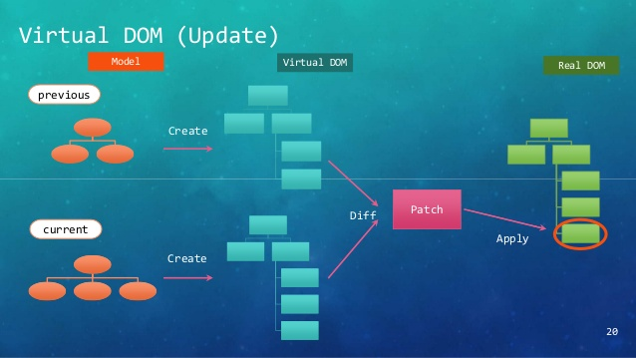
How Virtual DOM works

Slide 6
Data flow
In React JS, data flows in one direction, from Parent to Child. This helps components to be simple and predictable.
Consider React components as simple functions that receive props and state and return HTML.
When child components receive props from their parents, they either apply modifications (render) or pass it to another child that may use it.

Slide 7
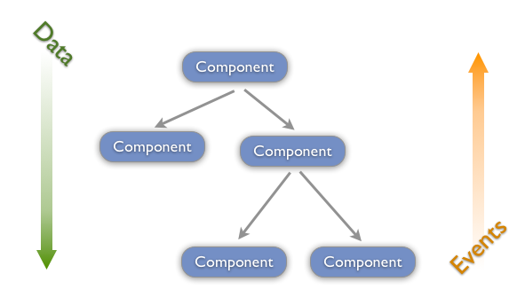
Data flow vs Events flow diagram

Slide 8
Components

